Slide 1
Ch3 Review Questions
© Copyright all rights reserved to Homework depot: www.BCMath.ca

Slide 2
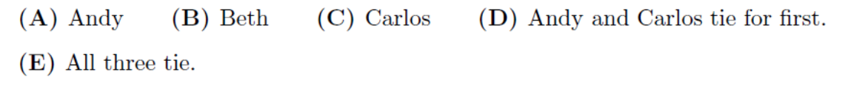
Q1: The scale on a map of Saskatchewan is 1 cm represents 50 km. The actual straight line distance between Regina and Saskatoon is about 257 km. What is the map distance between these 2 cities?
Q2: Andy’s lawn has twice as much area as Beth’s lawn and three times as much area as Carlo’s lawn. Carlo’s lawn mower cuts half as fast as Beth’s mower and one third as fast as Andy’s mower. If they all start to mow their lawns at the same time, who will finish first?
Q3: On average, Sara can travel four times as fast on cross-country skis as she can with showshoes. To travel 24km, she needs 6h more if she is showshoeing than if she skiing. What is her average speed on crosscountry skis?

Slide 3
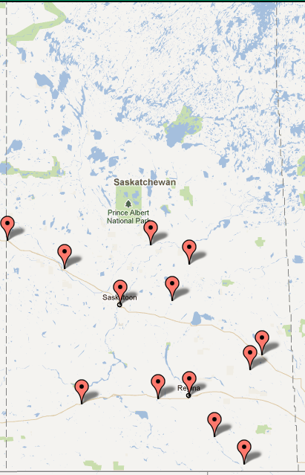
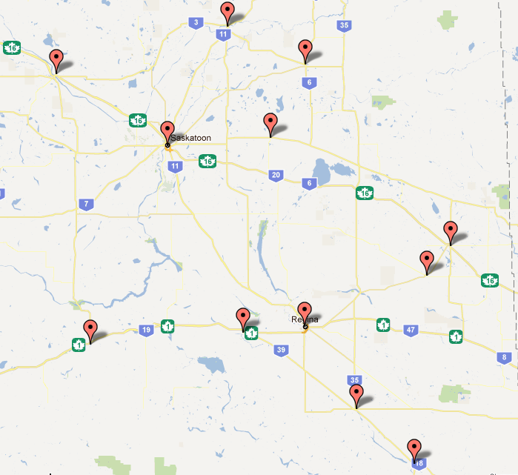
The scale on a map of Saskatchewan is 1 cm represents 50 km. The actual straight line distance between Regina and Saskatoon is about 257 km. What is the map distance between these 2 cities?
The scale is:
Saskatoon
Regina
Let “x” be the map distance between the two cities
The actual distance between the cities is 257km
Use the ratios to create an equation and solve
for “x”
The map distance is 5.14 cm

Slide 4
Amc 12b 2002

Slide 5
Q3: On average, Sara can travel four times as fast on cross-country skis as she can with showshoes. To travel 24km, she needs 6h more if she is showshoeing than if she skiing. What is her average speed on crosscountry skis?

Slide 7
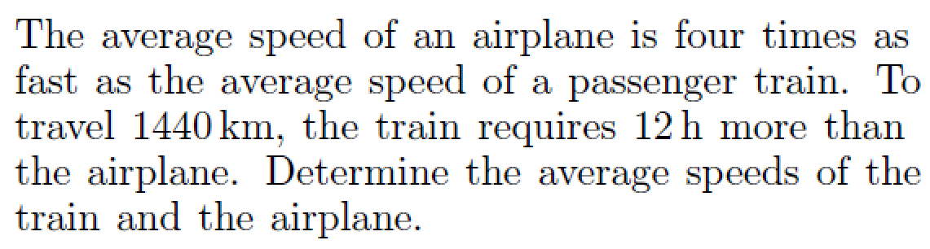

Slide 8
Challenge: Two boats on opposite sides of a river are heading towards the other side and coming back. They travel at different speeds and at constant speeds. When they first cross path, they are 720yards away from one side of the river. Once they reach the opposite side, they wait 10 minutes before leaving. They second time they cross path, they are 400 yards from one side. How wide is the river?

Slide 10
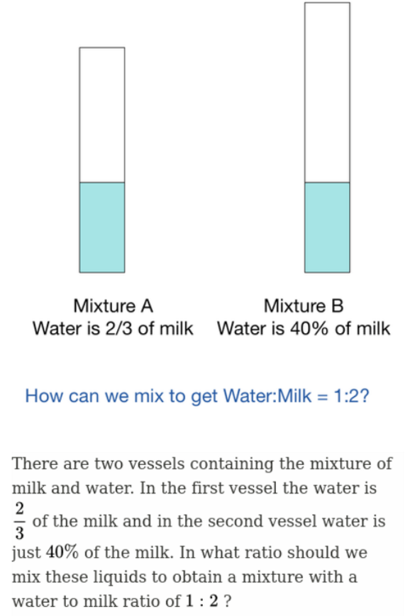

Slide 11
Challenge: Two boats on opposite sides of a river are heading towards the other side and coming back. They travel at different speeds and at constant speeds. When they first cross path, they are 720yards away from one side of the river. Once they reach the opposite side, they wait 10 minutes before leaving. They second time they cross path, they are 400 yards from one side. How wide is the river?

Slide 13
Amc 12b 2002

Slide 15
The scale on a map of Saskatchewan is 1 cm represents 50 km. The actual straight line distance between Regina and Saskatoon is about 257 km. What is the map distance between these 2 cities?
The scale is:
Saskatoon
Regina
Let “x” be the map distance between the two cities
The actual distance between the cities is 257km
Use the ratios to create an equation and solve
for “x”
The map distance is 5.14 cm

